Slide 1
SMART PROJECT MANAGEMENT SYSTEM
2021-234

Slide 2
Overall Project Description

Slide 3
Overall Project Description
Research Problem
Current student grouping process is not effective.
Managing and checking progress of projects is a exhausting process.
Existing project management systems doesn’t include a peer review facility.
Students having difficulty to find a project.

Slide 4
Research Gap
Features | Our Solution | Microsoft Project | Redmine | Jira
User Management. | ✓ | ✓ | ✓ | ✓
Project Group auto generation | ✓ | X | X | X
Suggest System common functionalities, Define Tasks and objectives that team wish to split | ✓ | ✓ | ✓ | ✓
suggest Functions for students which inserted by students | ✓ | X | X | X
Auto Generate Gantt Chart | ✓ | ✓ | ✓ | ✓
Weekly progress check by supervisor and feedbacks - Strict due date | ✓ | ✓ | ✓ | ✓
peer review.(Monthly) - peer review mark generation | ✓ | X | X | X
Predict future contribution percentage possibility using GitHub contribution | ✓ | X | X | X
Contact group members and leader via the application. | ✓ | X | ✓ | X
Notify students for incoming events and due date notifications(evaluation meetings). | ✓ | ✓ | ✓ | ✓
Issue Tracking | ✓ | ✓ | ✓ | ✓
Client meeting tracking using voice-to-text converter and facial recognition to calculate client satisfaction rate | ✓ | X | X | X
Propose projects by Clients- publicly access interface which can be used by clients as a project marketplace | ✓ | X | X | X
Client meetings via video and audio. | ✓ | X | X | X
Performance report which represents individual contribution to the project by each team member | ✓ | X | X | X
Overall performance mark generation | system grade generation | ✓ | X | X | X

Slide 5
Research Question
Is there a way to help students to find client projects?
Since the version controlling is playing a major role in industry, how can we motivate students to use version controlling for their products?
Is it effective to create student groups systematically for the projects?
Will be the grading system accurate if students themselves give feedbacks about their team mates?

Slide 6
Main Objective
Develop a Project Management System to improve team work skills among students and Automate current project management system.

Slide 7
Sub Objectives
Research Objectives
Develop a component to auto generate project groups to create balanced group.
Develop a component to peer review students to get an idea about each student.
Develop a component to track project progress using GitHub
Develop a component to track client meetings and record content using voice to text methodology.

Slide 8
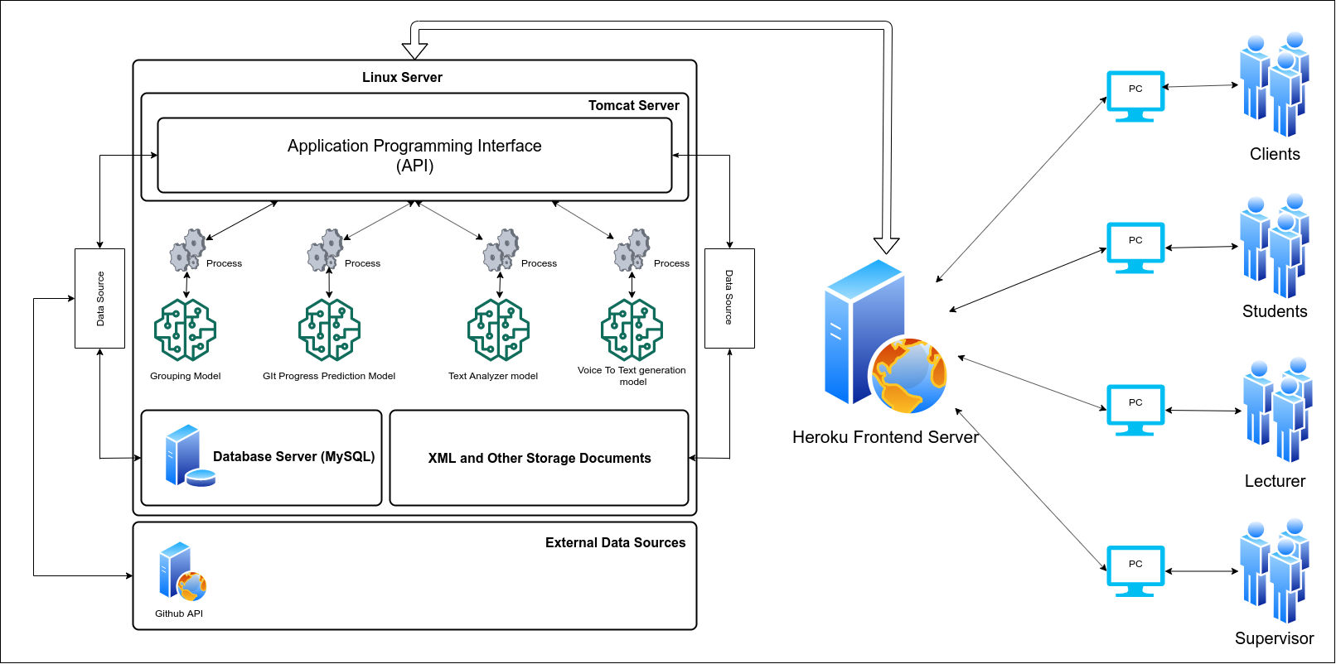
Overall Project Description
System Diagram

Slide 9


Commercialization
Users can download the free trial version with limited functionalities to a limited time period and if user satisfy with the product, They can purchase the system for the full price.
Since the target users are the universities, We can offer discounts for the product and they might considering to use the product.

Slide 10

IT18009446 Amarasekara T.N.E. IT
Research Section 1
Automate Project Group Generation

Slide 11
Introduction
Background
Research Question
Existing Researches & solutions
Research Gap
Specific and Sub Objectives

Slide 12

Background
Student Grouping for the group projects is a time consuming process.
According to the existing grouping strategies in project practical teaching, teachers often grouping students according to their,
Willingness
enrollment numbers
dividing them into groups at random [1].
Manual Grouping or the random grouping is not an effective or an efficient way to do it.

Slide 13

Research Question
Is random student group generation effective for group projects?
What are the other possible ways to automate group generation instead of random group generation?
What should be considered when we group students?

Slide 14
Existing Researches & Solutions
Title | Authors | Published Year
Effectively assign student groups by applying multiple user-prioritized academic and demographic factors using a new open source program, GroupEng | Dimiduk, T. G. Dimiduk, K. C. | 2011
Project practical teaching grouping strategy based on fuzzy clustering algorithm | Z. Wen-qiang W. Ben-ting | 2010
Dynamic group formation as an approach to collaborative learning support | Srba, I. Bielikova, M. | 2014
A system for supporting group exercise in software development with facilities to create an optimal plan of student grouping and team formation of each group | Hashiura, H. Kuwabara, T. Qiu, Y. Yamashita, K. Ishikawa, T. Shirakawa, K. Komiya, S. | 2008

Slide 15
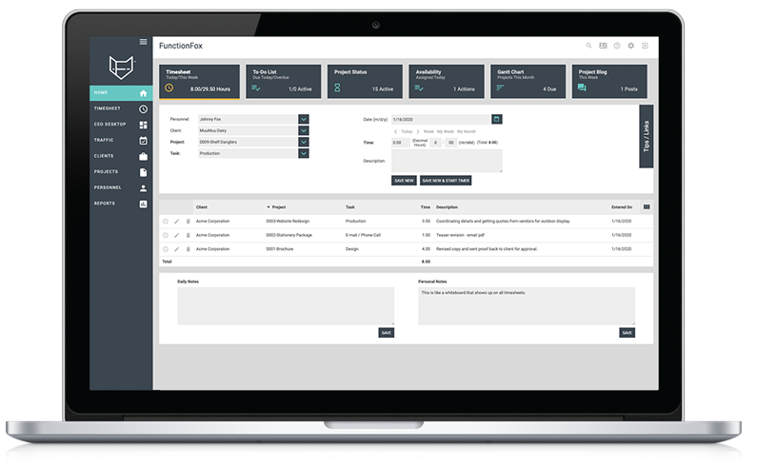
Research Gap
Existing grouping solutions are standalone systems.
GroupEng is a standalone group generate automation system[2].
Goal is to create a project management system with the capability to group students for the group project using skill-based grouping methodology.

Slide 16
Specific and Sub Objectives
Specific Objectives
Develop a grouping algorithm to automate student grouping process
Sub Objectives
Data collection.
Analyze the data and find relationships between data.
Using data analysis find an optimal algorithm or algorithms to achieve the expected results
Test algorithms and output a model that can be used for the grouping process.

Slide 17
Research Methodology
System Diagram
grouping algorithm
Technologies, techniques, algorithms to be used
System, personal, and software specification Requirements
Work breakdown structure
Gantt Chart

Slide 18
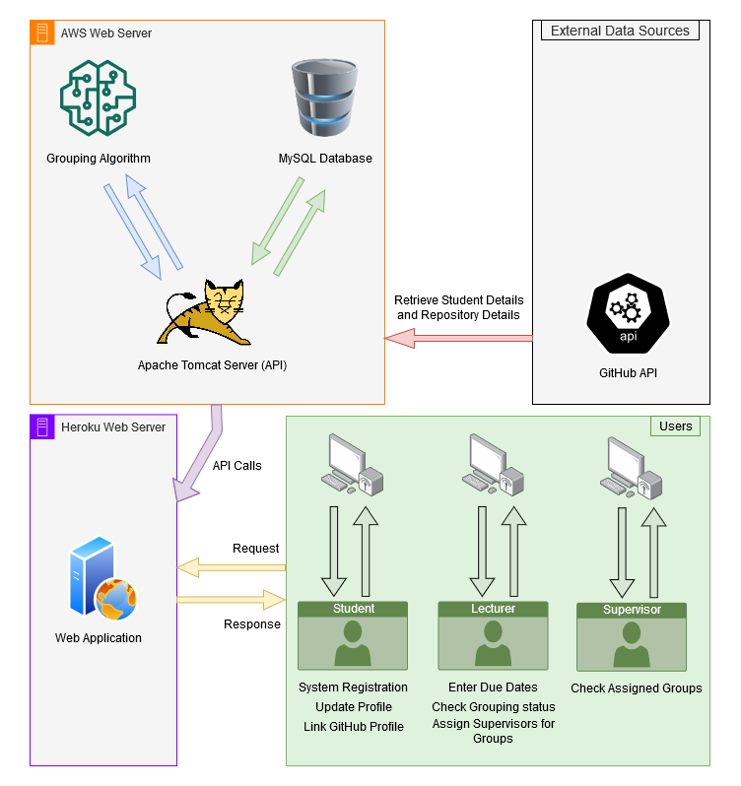
System Diagram
Components
AWS Web Server
MySQL Server
Tomcat Server
Grouping Algorithm
Heroku Web Server
Client Application
External Components
GitHub API
Users
Student
Lecturer
Supervisor

Slide 19
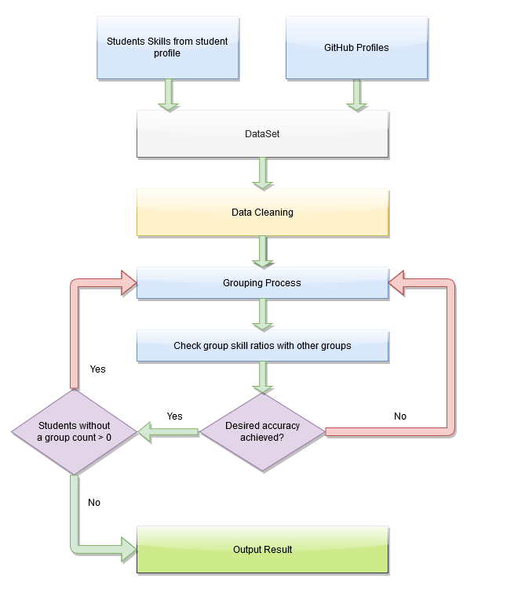
Grouping Algorithm
Data Requirements
Student GPA
Programming Skills
Base Languages
Frameworks
DBM systems
Version Controlling
Previous Projects
Used programming languages
GitHub Repositories
Used programming languages

Slide 20








Technologies, Techniques, Algorithms to be used
Technologies
API (Application Programming Interface)
Maven Quarkus
Database Server
MySQL
Model Training
Python
Fuzzy Clustering Algorithm[3] and heterogeneous grouping instead of Homogeneous grouping approach.

Slide 21
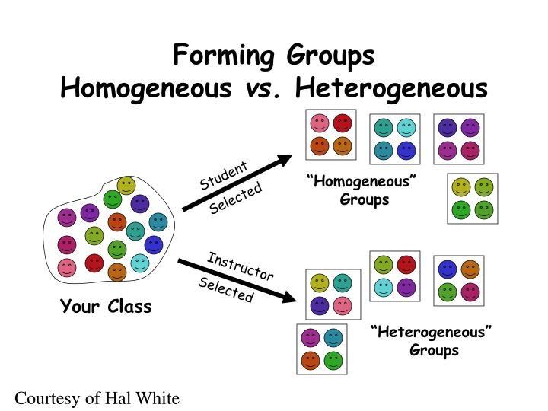
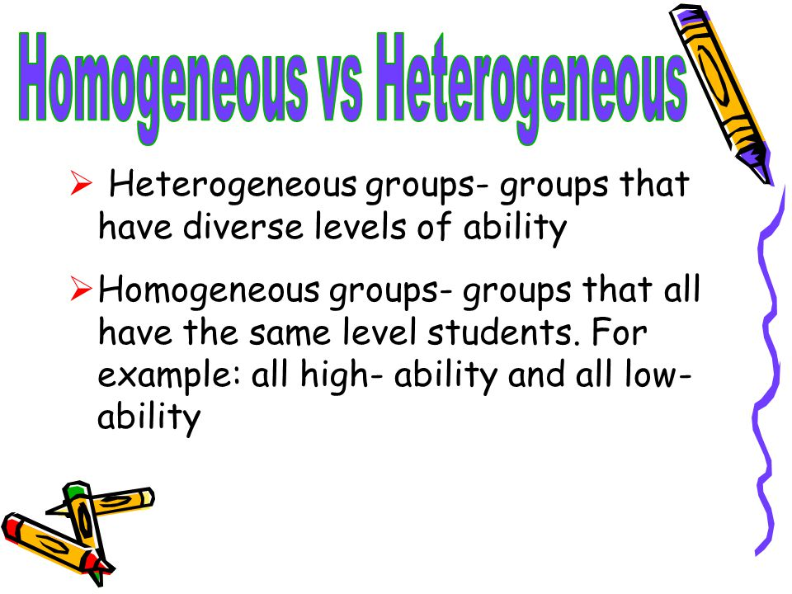
Technologies, Techniques, Algorithms to be used

Slide 22
System, Personnel, and Software Specification Requirements
System
Personnel
Software Specification
Web Browser with capability to run javascript commands.
Basic knowledge to handle a project management system.
An Administrator who can handle web contents and database.
Aws virtual host environment included with MySQL Server, Apache Server and Python.

Slide 23
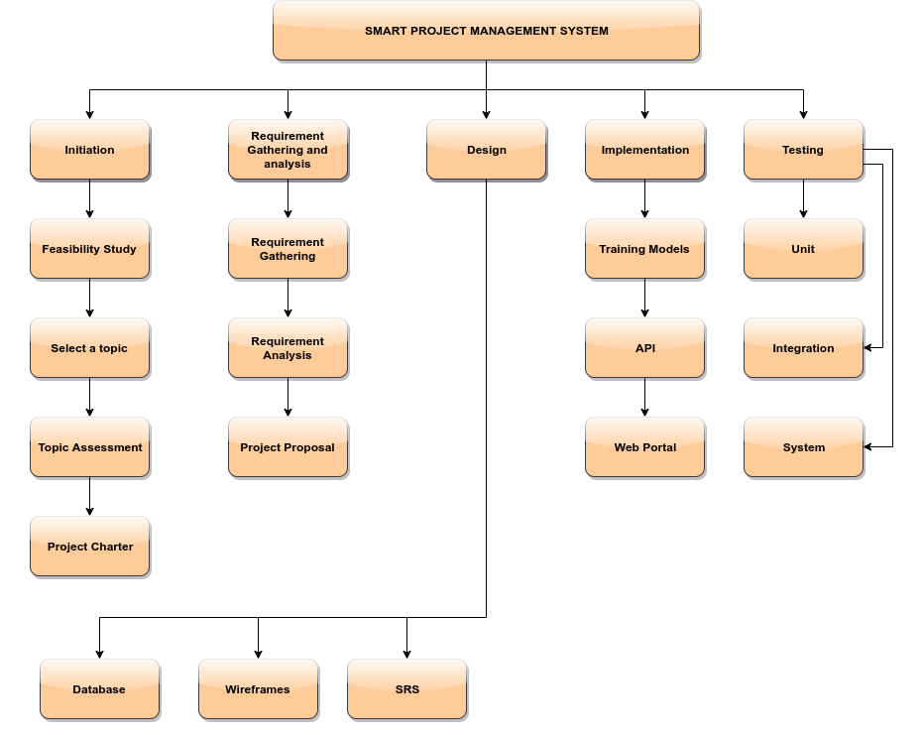
Work Breakdown Structure

Slide 24
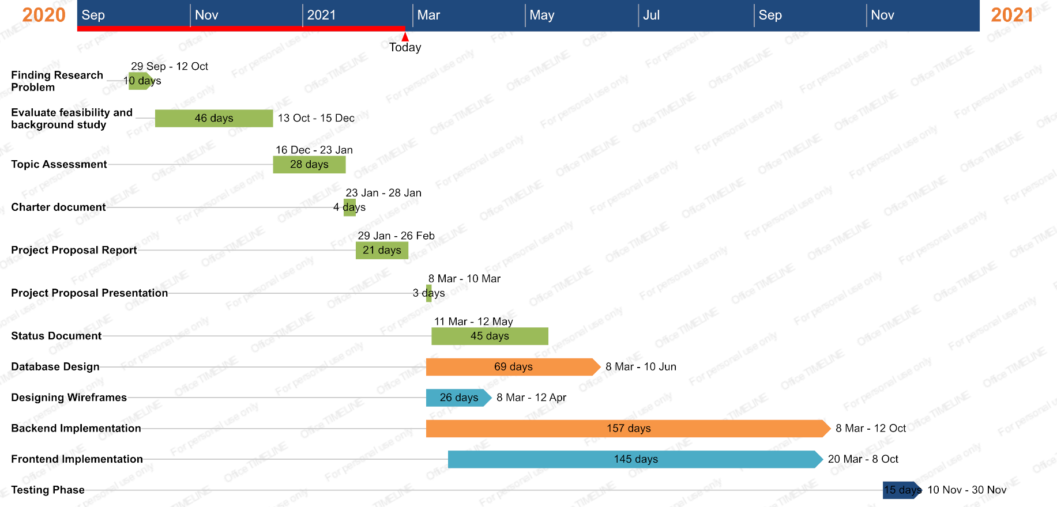
Gantt Chart
Initial Dates
Database Design – Mar 8
Wireframe Design – Mar 8
Backend Implementation - Mar 8
Frontend Implementation – Mar 20
Testing Phase – Nov 10
Target Finish Date – Nov 30

Slide 25
Supportive information
Commercialization
Budget

Slide 26

Commercialization
Since the student grouping feature is not integrated with any other current project management systems and also it is a required functionality in any university, we can market this solution to any existing university.
In industry, companies also find difficult to choose right employees to select for a selected project. Since the grouping functionality is integrated with this system, We can propose this system for the industry as well.

Slide 27
Budget
Resource Type | Cost (Weekly) | Cost (Monthly) | Cost For 10 Months
Network based on usage | = 372.5/Rs | = 1490/Rs | 1490 * 10 = 14900/Rs
Mobile Usage | 2Rs/min 2 * 10 * 7 = 140/Rs | 140 * 4 = 560/Rs | 560 * 10 = 5600/Rs
Banner and other Printouts | - | - | = 3000/Rs
Total | Cost(Weekly) = 512.5/Rs | Cost(Monthly) = 2050/Rs | Cost For 10 Months = 23500/Rs

Slide 28
References
[1] Chen Di and Jiang Bei-zhan, “Some Problems in Teaching ‘Educational Technology in Project Teaching’”, Journal of e-Education Research,pp.63-65 2007.
[2] Dimiduk, T. G., & Dimiduk, K. C. (2011, December). Effectively assign student groups by applying multiple user-prioritized academic and demographic factors using a new open source program, GroupEng. In 2011 WEPAN Nat. Conf. Advancing Women: Transforming Eng. Educ (pp. 1-12).
[3] Z. Wen-qiang and W. Ben-ting, "Project practical teaching grouping strategy based on fuzzy clustering algorithm," 2010 5th International Conference on Computer Science & Education, Hefei, China, 2010, pp. 678-681, doi: 10.1109/ICCSE.2010.5593662.
[4] Srba, I., & Bielikova, M. (2014). Dynamic group formation as an approach to collaborative learning support. IEEE transactions on learning technologies, 8(2), 173-186.
[5] Hashiura, H., Kuwabara, T., Qiu, Y., Yamashita, K., Ishikawa, T., Shirakawa, K., & Komiya, S. (2008, February). A system for supporting group exercise in software development with facilities to create an optimal plan of student grouping and team formation of each group. In Electrical And Computer Engineering Series. Proceedings of the 7th WSEAS International Conference on Software Engineering, Parallel and Distributed Systems. Cambridge, UK (pp. 149-157).

Slide 29

IT18140330 Gamage O.M. SE
Research Section 2
Predict future GitHub contribution and progress tracking

Slide 30
Introduction
Research Question
Existing Researches & solutions
Research Gap
Objectives

Slide 31

Research Question
Are Students usually use any version controlling systems for their university modules?
Can we track GitHub users project? How we are going to track the progress?
Are there any existing project management system to predict contribution and track the project progress using GitHub?
What should be considered when we track the progress?
Are there any Incorporating version controlling facilities in project management?

Slide 32
Existing Researches & Solutions
Topic | Author | Year
Using Dynamic and Contextual Features to Predict Issue Lifetime in GitHub Projects | IEEE | 2016
Healthy or Not: A Way to predict ecosystem health in GitHub | Zhuang Liao, Mengjie Yi, Yan Wang, Shengzong Liu, Hui Liu and Yan Zhang | 2019
GitHub User insight using GitHub API – Data Collection and Analysis, | Karan Bhanot | 2019
Predicting the Popularity of GitHub Repositories | Hudson Borges, Andre Hora and Macro Tulio Valente | 2016

Slide 33

Research Gap
Predict GitHub Contribution Using GitHub REST API [1].
Measure and Analysis both volume and the quality of the code.
“A Way to predict ecosystem health in GitHub”[4], “Using Dynamic and Contextual Features to Predict Issue Lifetime in GitHub Projects” [5] Existing systems are made for a single task.
Some solutions are complex to be develop and some them are not enough to configure and satisfy our requirements.
Provide a progress report and a grade using overall commit progress, user contribution to the project and quality of the code

Slide 34

Objectives
Predict Future Contribution and progress tracking using GitHub REST API.
Sub Objectives
Create system component to Track the project progress using GitHub REST API.
Creating Issue Tracking system similar as stack overflow.
Notify students for incoming events and due date notifications.
Generating Performance report which represents individual contribution to the project by each team member

Slide 35
Research Methodology
Methodology
System Diagram
Technologies and tools
System, Personnel, and Software Specification Requirements
WBS
Gantt chart

Slide 36
Methodology
Project Management System with four users.
Predict Future Contribution of the student group project using GitHub REST API.
Supervisors and team members can get a rough idea about the project progress.
Why we can’t use the GitHub platform to get the progress?
Generate a mark using GitHub progress.
Refer GitHub Documentation to analysis how to configure GitHub REST API
Functional and non-functional testing.
Deployment in AWS and Heroku.

Slide 37
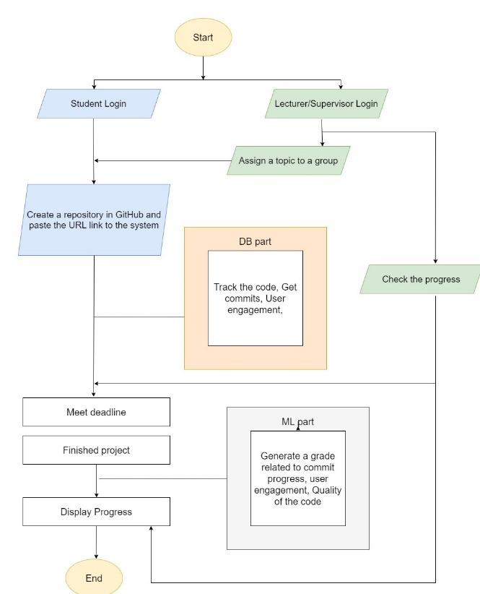

System Diagram
Algorithm
Fetch data from the GitHub repositories and predict future progress
There is no existing Algorithm
External Components
GitHub REST API
Users
Student, Lecturer/ Supervisor

Slide 38





Technologies and Tools
Client side - HTML, CSS, JS (jQuery, React JS)and Redux
Server Side – Java, Python
Database – MySQL
Communication - REST, AJAX, JSONs
Tools - Visual Studio Code, Apache Server, Eclipse IDE, Postman

Slide 39
System, Personnel, and Software Specification Requirements
System
Personnel
Software Specification
Web Browser with capability to run JavaScript.
Basic knowledge to handle a project management system.
GitHub Account
Basic knowledge of GitHub.
Aws virtual host environment included with MySQL Server, Apache Server and Python.

Slide 40
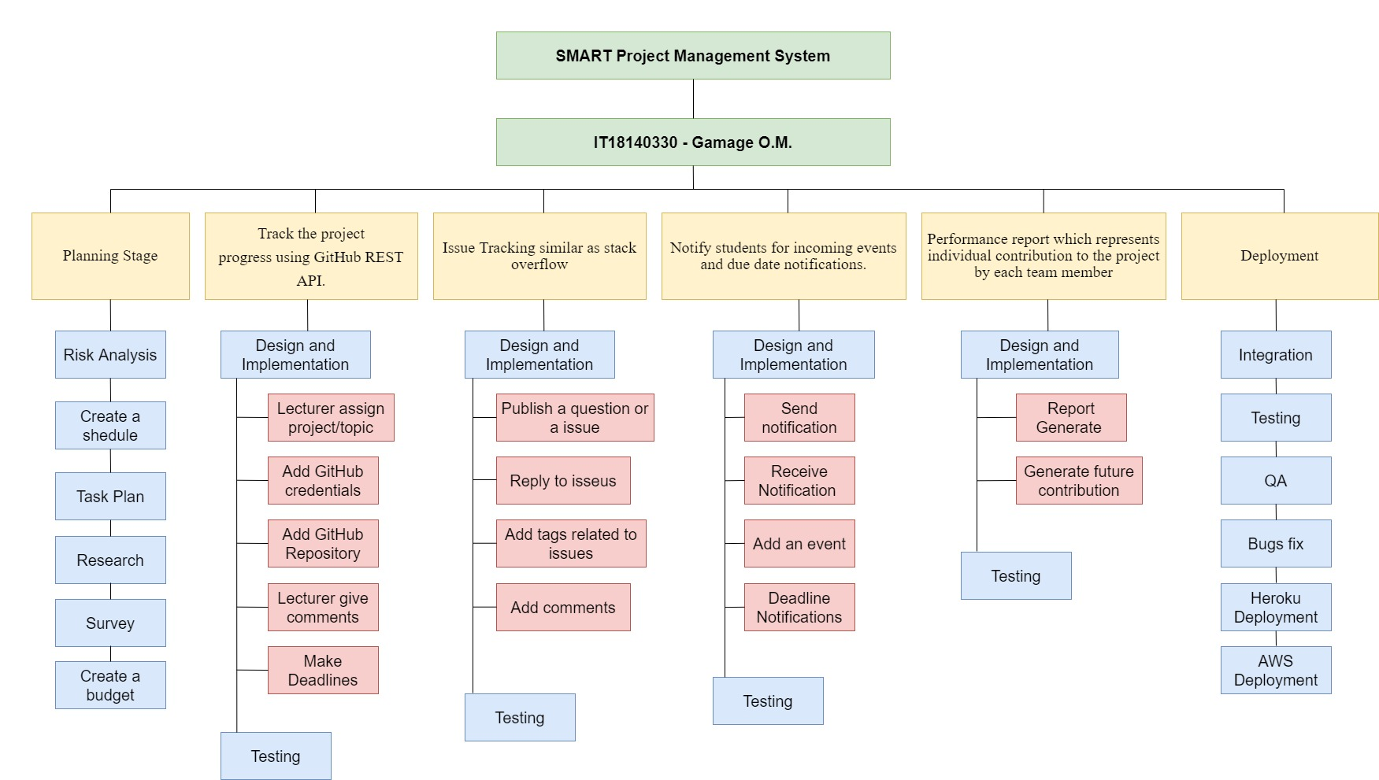
Work Breakdown Structure

Slide 41
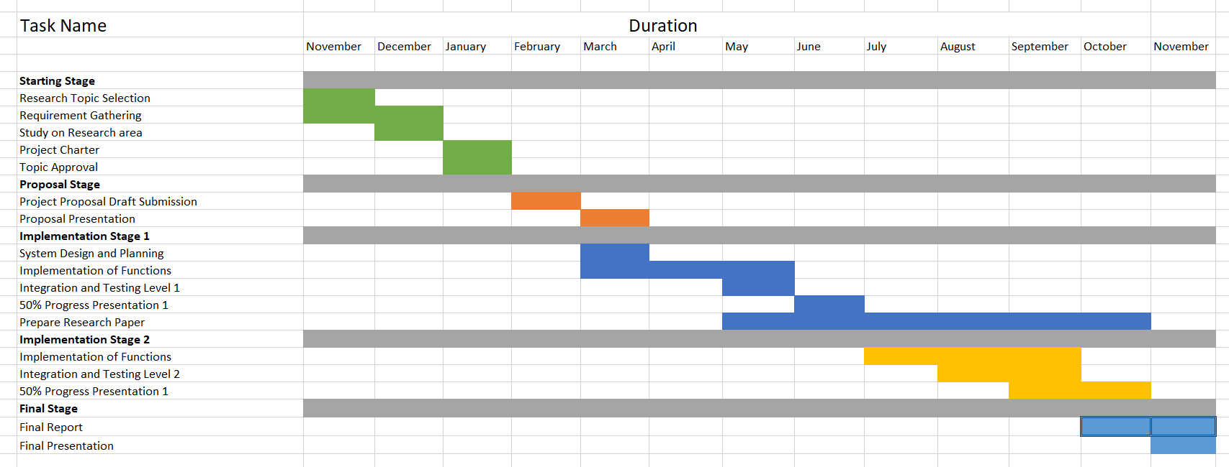
Gantt Chart

Slide 42
Supporting Items
Commercialization
Budget

Slide 43

Commercialization
This System is for SLIIT, ITPM module. So we are focusing only 2nd year students.
This is a Project Management System with all functionalities. So we planned to go through to the Industry.
Complete Overall system using existing systems.
Plan to develop to manage a real-world industry projects management system.

Slide 44
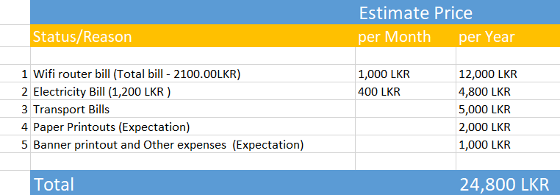
Budget

Slide 45
References
[1] GitHub User insight using GitHub API – Data Collection and Analysis, Available at https://towardsdatascience.com/github-user-insights-using-github-api-data-collection-and-analysis-5b7dca1ab214
[2] GitHub Documentation Guide, ”Repositories”, Available at https://docs.github.com/en/rest/reference/repos
[3] GitHub Documentation Guide, “ Users “ , Available at https://docs.github.com/en/rest/reference/users
[4] IEEE, “Using Dynamic and Contextual Features to Predict Issue Lifetime in GitHub Projects”, 2016 IEEE/ACM 13th working Conference on MSR.
[5] Zhuang Liao, Mengjie Yi, Yan Wang, Shengzong Liu, Hui Liu and Yan Zhang, “Healthy or Not: A Way to predict ecosystem health in GitHub”, 28 January 2019

Slide 46

IT18129236 Isurindi H.G.P IT
Research Section 3
Track client meetings and document meeting content using voice to text conversion.

Slide 47
Introduction
Research Question
Existing Researches & solutions
Research Gap
Objectives

Slide 48

Research Question
Can Students remember all the client requirements? Or what they communicated with the client?
Are there any existing systems for this research part?
Are students need to take notes in a meeting? Or Are Students need to remember all the details from the client meeting?
Can the client can track the project progress? And Can the client blame for the project coordinators for any failures?

Slide 49
Existing Researches & Solutions
Topic | Author | Year
An Introduction to Face Recognition Technology | Shang-Hung Lin | 2000
Face recognition methods and applications | Cornell University | 2014
Voice Identification Using Classification Algorithms | Orken Mamyrbayew, Nurbapa Mekebayev, Mussa Turdalyuly, Nurzhamal Oshanova, Tolga Ishsan Medeni and Aigerim Yessentay | 2019
Overview of the Speech Recognition Technology | IEEE | 2012

Slide 50
Research Gap
Generate the Final report form the client meetings.
Existing systems are outputting only a result that related to face or speech.
Consider about the face recognition, system gives a result related to face expressions. From the Speech recognition, system give some texts related to his or her voice.
Generate Report will include speech recognition system’s text report and the face recognition system’s client satisfaction rate.

Slide 51
Objectives
The main objective is face and speech recognition into auto generated report and a satisfaction rate.
Creating client meeting platform
Client portal which provide facility to propose projects
Suggest Functions for students which inserted by students

Slide 52
Research Methodology
Methodology
System Diagram
Technologies and tools
WBS
Gantt chart

Slide 53
Methodology
Project Management System with four users, this part mainly focus the client and student.
Client meeting tracking using voice-to-text converter and facial recognition to calculate client satisfaction rate.
Student can check the meeting logs anytime. If they missed or forgot anything, they can check the meeting log.
Auto generate a report of the meeting and the content.

Slide 54
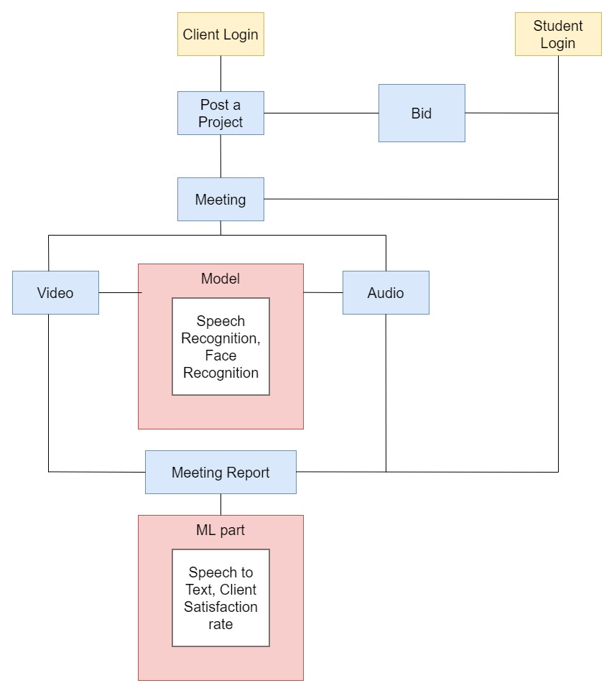

System Diagram
Components
AWS Web Server
MySQL Server
Tomcat Server
Heroku Web Server
Web Application
External Components
Users
Student, Clients

Slide 55
Technologies and Tools
Client side - HTML, CSS, JS (jQuery, React JS)and Redux
Server Side – Java, Python
Database – MySQL
Communication - REST, AJAX, JSONs
Tools - Visual Studio Code, Apache Server, Eclipse IDE, Postman

Slide 56
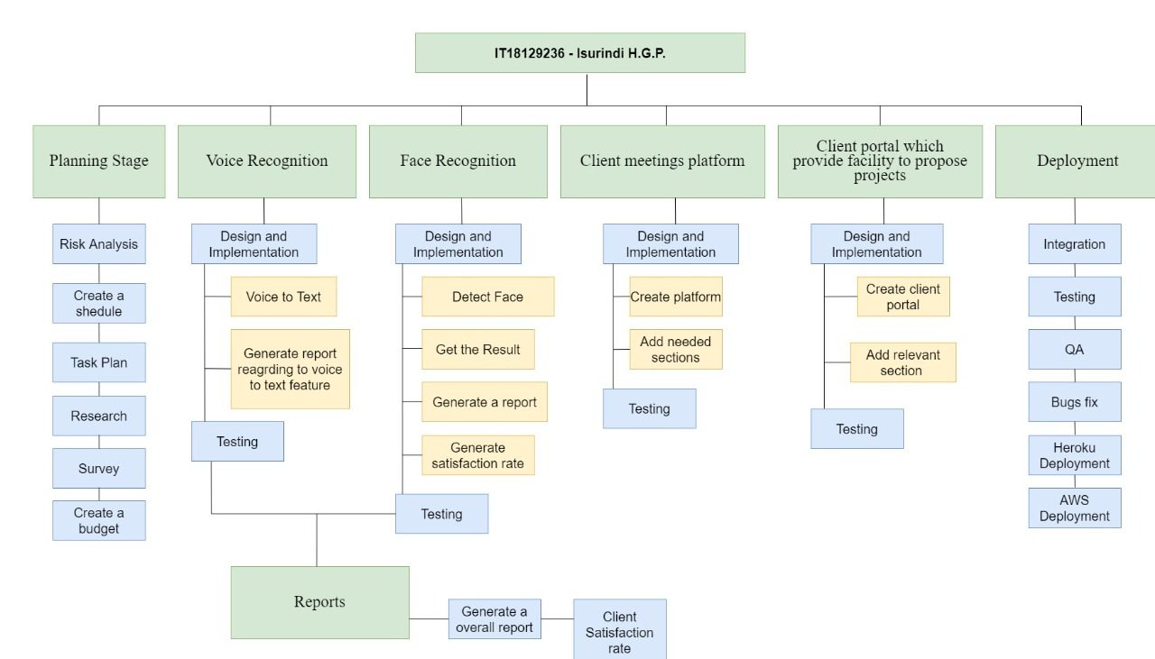
Work Breakdown Structure

Slide 57
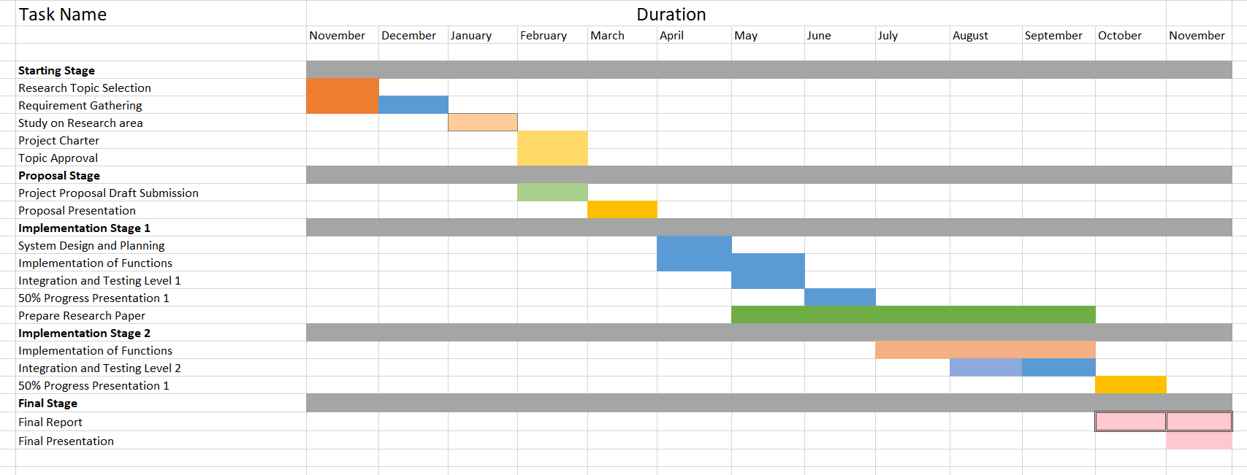
Gantt Chart

Slide 58
Supporting Items
Commercialization
Budget

Slide 59

Commercialization
Project Management System with all functionalities including All the Client meeting requements and client satisfaction rate.
A system which can be upgraded to use for any university and it very supportive there all projects .
A Highly customizable Open Source Project Management System
By giving a free trial to earn customer satisfaction.

Slide 60
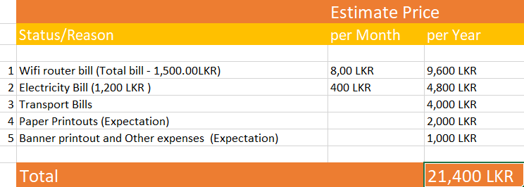
Budget

Slide 61
References
[1] Lowerre B.T. , “The Happy Speech Recognition System”, Ph.D. Thesis Carnegie-Mellon University, Pittsburgh, PA, Available at
[2] “Face recognition methods and applications” , Cornell University, 2014, Available at https://arxiv.org/abs/1403.0485
[3] Relationships between SCL theories and methods, adapted from Bishop and Verleger (Bishop and Verleger2013)
[4]The Free Rider and Cooperative Learning Groups: Perspectives from Faculty Members Geri McArdle Kimberly D. Clements Kim Hutchinson- Lendi

Slide 62

IT18003642 Navanjana E.H.D.T.D. IT
Research Section 4
Peer review assessments for
undergraduate projects

Slide 63
Introduction
Research question
Research Gap
Objectives

Slide 64
Research Question
How to detect Free riders in the group project?
Free riders are individuals who decide not to participate in cooperative learning group activities and often
lower the group’s morale, productivity, and effectiveness.[4]

Slide 65
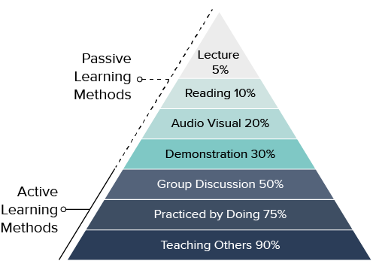
Research Gap
The intention of developing a team-based learning assignment was to break out of the normal format and encourage active learning. [1]

Slide 66
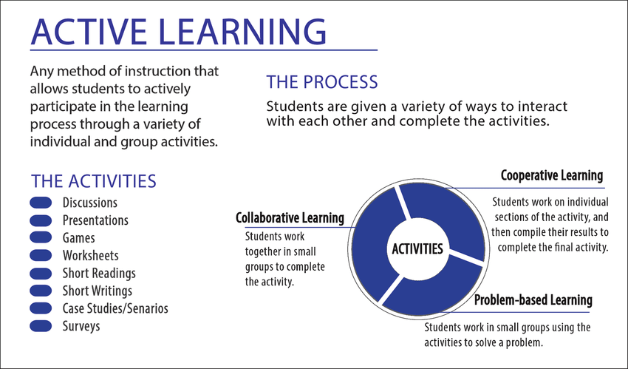

Slide 67
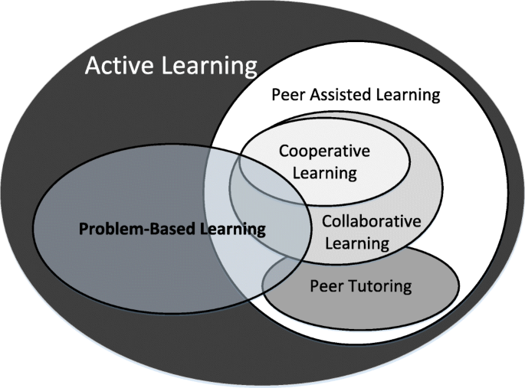
Research Gap
Cooperative Learning[2][3]
Effective communication
Presentation / Viva
____

Slide 68
Main Objective
Peer Review Assessments + Aspect Based Sentiment analysis
SA
Sentiment analysis is the automated process of analyzing text to determine the sentiment expressed (positive, negative or neutral).
ABSA
technique that takes into consideration the terms related to the aspects and identifies the sentiment associated with each aspect.

Slide 69
Related research studies
Product Analysis
Brand Monitoring And Reputation Management
Social Media Monitoring
Voice Of Customer (Voc)
Sentiment analysis
Customer Support
Voice Of Employee
Customer Feedback
Market Research And
Competitive Research

Slide 70
Related research studies
product reviews [5] – Ecommerce (Product Quality)
tweets [6] – Social media (Hate speech, False information)
news articles [7] – Communication (Content Coverage)
movie reviews [8] – Entertainment

Slide 71
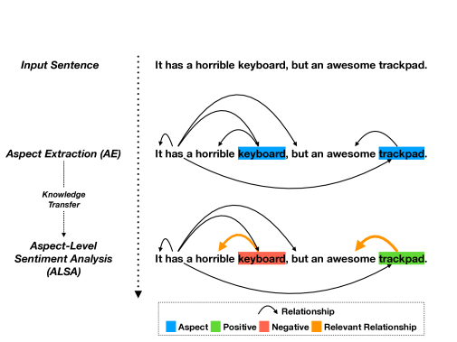
Related research studies

Slide 72
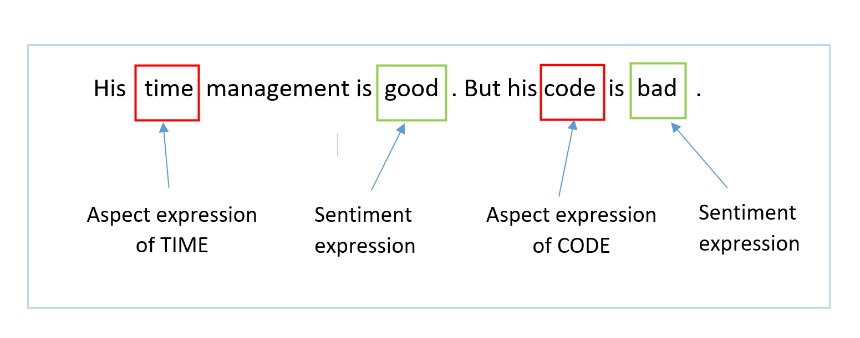
Related research studies
ABSA
Aspect Based
Sentiment analysis

Slide 73
Sub Objective
ITP
M1- Jan
W1
W2
WBS
L1
L2
L3
W3
W4 - PR
WBS
Work Breakdown
Structure

Slide 74
Research Methodology
Methodology
System Diagram
Technologies and tools
Gantt chart

Slide 75
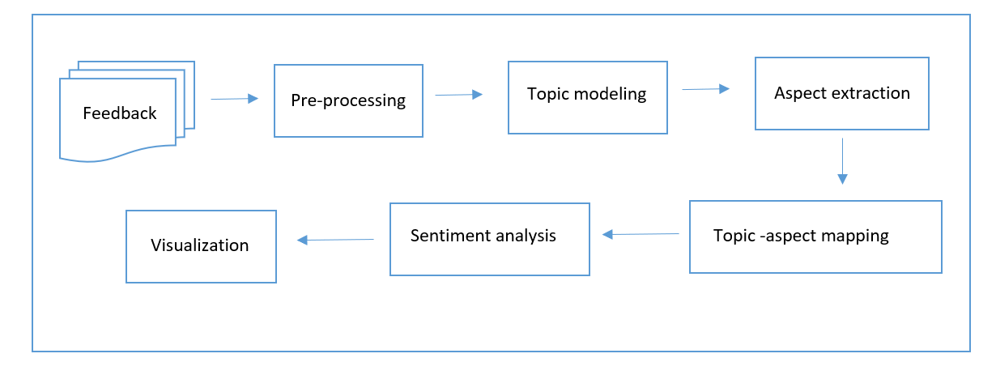
Methodology
In aspect-based approach first models topics from peer reviews, which are a collection of word uni-grams and then extracts aspects from it.
Based on the probability, we map these topics to corresponding aspects, and then aspect-level polarity is computed, and using Naive Bayes classifier, we classify sentiments.

Slide 76
Methodology
Pre-processing is performed for converting raw text file into a well-defined sequence of linguistically meaningful unit.
Split by whitespace
Remove punctuation
Normalizing case
Remove stop words

Slide 77
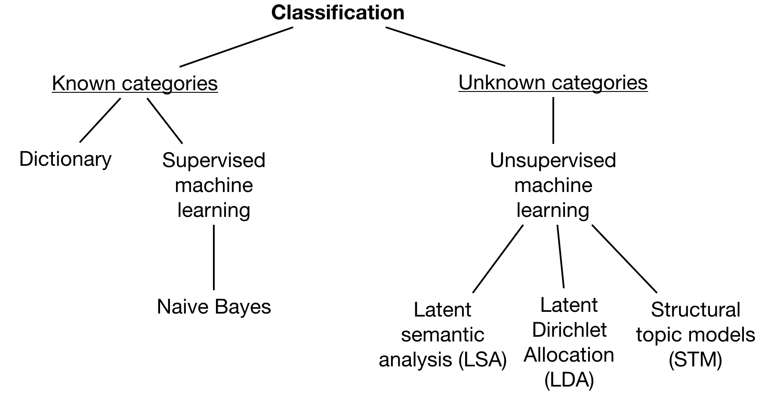
Methodology
Topic modeling, the LDA algorithm (Latent Dirichlet Allocation) is executed on top of this cleansed dataset to generate topics.

Slide 78
Methodology
Sentiment Classification, the Naive Bayes classifier is executed on top of this labeled dataset to classify topics.
It can also be trained on small dataset.

Slide 79
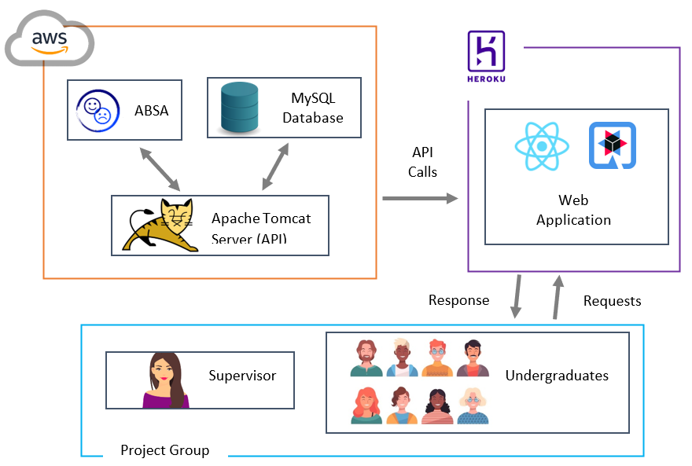
System Diagram

Slide 80

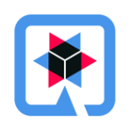


Technologies and Tools
Client side - HTML, CSS, JS (jQuery, React JS)
Server Side – Java, Python, Quarkus
Database – MySQL
Tools - Visual Studio Code, Apache Server, Eclipse IDE, Postman

Slide 81
Work Breakdown Structure
Planning Stage
Risk Analysis
Shedule Management
Frontend WBS
Design and imp.
Peer Review
Backend
ABSA
Design and imp.
Task Planning
Research
Survey
Budget Planning
Milestones
Time based counter
Lockdown function
Testing
Tree Structure
Testing
ABSA component
WBS integration
data base
Deployment
Integration
Testing
QA
Bug's fix
Heroku Deployment
AWS Deployment
Microservice and API

Slide 82
Gantt Chart
Task Name | Duration
 | Nov | Dec | Jan | Feb | Mar | Apr | May | Jun | Jul | Aug | Sep | Oct | Nov
Starting Stage
Research Topic Selection
Requirement gathering
Study on research area
Project Charter
Topic Approval
Proposal Stage
Proposal draft submission
Proposal Presentation
Implementation Stage 1
System Design
System Planning
Implementation 1
Integration 1
Testing 1
Progress presentation 1
Prepare research paper
Implementation Stage 2
Implementation 2
Integration 2
Testing 2
Progress presentation 2
Final Stage
Final Report
Final presentation

Slide 83
Supporting Items
Commercialization
Budget

Slide 84

Commercialization
ITP + ABSA + WBS
Internet-based
Freeride Detection Service
Internet-based
Plagiarism Detection Service
Empower students for active learning with projects
Empower students to do their best, original work

Slide 85
Budget
Internet package (Tutorials, Meetings) – SLR 2000 x 10 = SLR 20000.00
Transport Cost – SLR (500+500)x 5 = SLR 5000.00
Hosting (Ngrok PRO) – USD 50(10x5) ~= SLR 10000.00*
Other (AWS EC2,S3 additions) – SLR 500 x 10 = SLR 5000.00*
= SLR 40000.00

Slide 86
References
[1] Group Project Work and Student-centered Active Learning: Two different experiences David Livingstone &Kenneth Lynch
[2] Maxey-Harris, Charlene & Dawes, Lorna. (2015). Building A Scholarly Network In Learning Communities at the University of Nebraska-Lincoln
[3] Relationships between SCL theories and methods, adapted from Bishop and Verleger (Bishop and Verleger2013)
[4]The Free Rider and Cooperative Learning Groups: Perspectives from Faculty Members Geri McArdle Kimberly D. Clements Kim Hutchinson- Lendi
[5] John Blitzer, Mark Dredze, and Fernando Pereira. 2007. Biographies, Bollywood, Boom-boxes and Blenders: Domain Adaptation for Sentiment Classification.. In ACL. 187–205.
[6] Xinjie Zhou, Xiaojun Wan, and Jianguo Xiao. 2016. Attention-based LSTM Network for Cross-Lingual Sentiment Classification. In EMNLP. 247–256.
[7]Namrata Godbole, Manjunath Srinivasaiah, and Steven Skiena. 2007. LargeScale Sentiment Analysis for News and Blogs. In International Conference on Weblogs and Social Media.
[8] Peter D. Turney. 2002. Thumbs up or thumbs down?: semantic orientation applied to unsupervised classification of reviews. In ACL. 417–424.

Slide 87


